Slide 1
Heap Data Structure
Atique Zafar

Slide 2
Why Do We Need Heaps?
In many real-life applications, we need to access the highest (or lowest) priority item quickly.
Example Scenarios:
  Task Scheduling: Tasks with higher urgency are executed first.
  Hospital ER System: Critical patients are attended before others.
  CPU Process Scheduling, Packet Routing, AI Pathfinding (Dijkstra's).
This requires a Priority Queue — and heaps are the most efficient way to implement one.

Slide 3
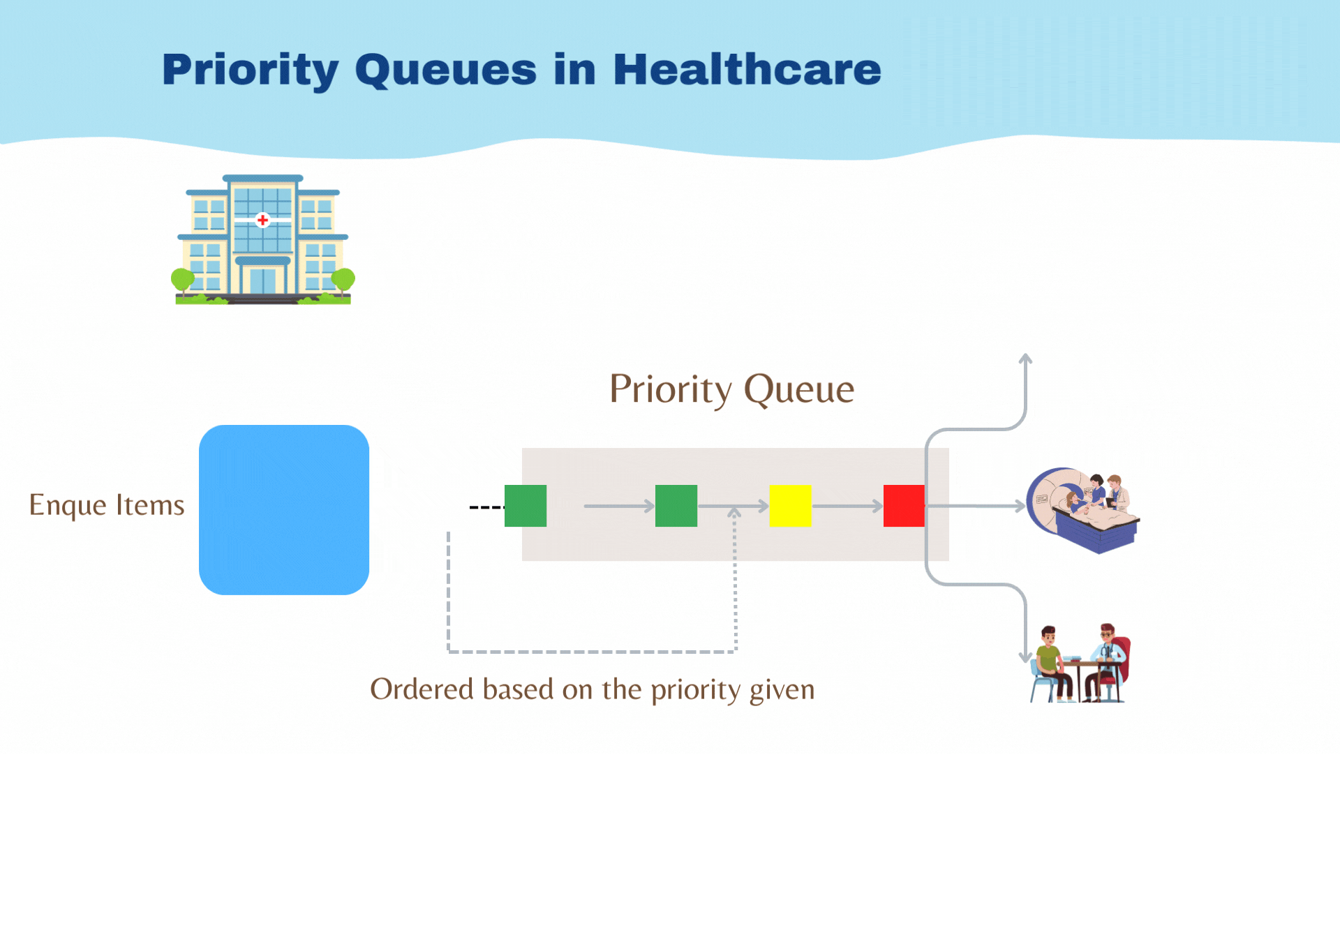

Slide 4
Complete Binary Tree — Foundation of Heaps
Consider a binary tree T.
Each node of the binary tree can have at most 2 children.
Each depth d of T can have at most 2^{d} nodes.
The tree T is said to be complete
  if all its levels ( except possibly the last ) have the maximum number of possible nodes ,
  And if the last level does not have the maximum number of nodes , then nodes appear as far left as possible.
Why is this important for heaps?
Heaps are always complete binary trees.
  This structure ensures:
      Efficient array-based representation (no gaps in memory).
      Guaranteed O(log n) time for insertion and deletion, since operations only follow a single path from root to leaf or vice versa.

Slide 5
Tree
Complete Binary Tree
1
2
3
4
5
6
Fig : Complete Binary Tree

Slide 6
Heap
A Heap is a binary tree that satisfies two properties
  Shape property: A heap must be a complete binary tree
  Order property: For every node in the heap, the value stored in that node is greater than or equal to the value in each of its children (MaxHeap).
Suppose H is a complete binary tree with n elements.
The H is called a heap , or a maxheap , if each node N of H has the following property :
  The value at N is greater than or equal to the value at each of the children of N.
A minimum heap is defined similarly : The value at N is less than or equal to the value at any of the children of N.

Slide 7
Tree
Representation of Tree in Array
60
50
55
22
30
44
1
2
3
4
5
6
60 | 50 | 55 | 22 | 30 | 44
Sequential Representation

Slide 8
Why Implement Heaps Using Arrays?
Heaps are complete binary trees — fully filled except last level (left to right).
This structure has no gaps, so nodes can be stored sequentially in an array.
No need for pointers or dynamic memory like binary trees.
We can easily calculate:
    Parent of i: ⌊i / 2⌋
    Left child: 2 × i
    Right child: 2 × i + 1
Advantages:
    Fast index computation
    Space-efficient
    Better cache locality and simpler to implement

Slide 9
Why Heap Operations Are O(log n)
Insert may need to “bubble up” from bottom to root: O(log n) swaps.
Delete (usually root) moves last node to root, then “heapifies down”: O(log n) steps.
Each level has at most 1 comparison/swapping step.
Key Insight:
  We are never traversing the entire heap — just following a path from root to leaf or leaf to root.

Slide 10
Calculating the position of Root and Left-Right Child with 1 and 0 based indexing
If Tree[k] is the root of the Heap , then T[2k] is left child and T[2k+1] is the right child of the root node.
Also , for any node Tree[j] , the node Tree[j/2] is the parent of Tree[j].
Relationship | 1-based indexing | 0-based indexing
Left child | 2k | 2i + 1
Right child | 2k + 1 | 2i + 2
Parent | j / 2 | (i - 1) // 2

Slide 11
Inserting into a Heap
Suppose H is a heap with N elements , and suppose an ITEM of information is given , We insert ITEM into the heap as follows :
  First adjoin ITEM at end of H so that H is still a complete tree , but not necessarily a heap.
  The new ITEM rise to its “appropriate place” in H so that H is finally a heap.
The new ITEM rises to its appropriate place in H so that H becomes a heap again.
This upward adjustment is called percolating up (or shift up), and is part of maintaining the heap property during insertion.

Slide 12
Example
Suppose we want to build a heap H from the following list of numbers :
44,30,50,22,60,55,77,55

Slide 13
Insert 44
11
44,30,50,22,60,55,77,55
44

Slide 14
Insert 30
12
44,30,50,22,60,55,77,55
44
30

Slide 15
Insert 50
44,30,50,22,60,55,77,55
44
50
30
50
30
44
Insertion
Adjustement

Slide 16
Insert 22
44,30,50,22,60,55,77,55
50
30
44
22

Slide 17
Insert 60
44,30,50,22,60,55,77,55
50
50
30
40
60
40
22
22
30
60
Insertion
First Adjustment

Slide 18
Insert 60 ( Contd )
44,30,50,22,60,55,77,55
60
50
40
22
30
Second Adjustment

Slide 19
Heap Insertion (Max Heap) – Step-by-Step Algorithm
Initialize:
Let heap[] be the array representing the heap.
size is the current number of elements in the heap.
MAX_SIZE is the max capacity of the heap.
Input the value to be inserted and assign to variable data
If (size >= MAX_SIZE)
  (a) Display "Heap Overflow"
  (b) Exit
  Else
  (a) size = size + 1
  (b) heap[size] = data
Set i = size
While (i > 1 and heap[i] > heap[i/2])
  (a) Swap heap[i] with heap[i/2]
  (b) i = i / 2
  Exit

Slide 20
Implementation in C++
const int MAX_SIZE = 100;
int heap[MAX_SIZE + 1]; // 1-based indexing, heap[0] unused
int size = 0;
void insert(int data) {
if (size >= MAX_SIZE) {
cout << "Heap Overflow" << endl;
return;
}
size++;
heap[size] = data;
int i = size;
while (i > 1 && heap[i] > heap[i / 2]) {
// Swap heap[i] with heap[i/2]
swap(heap[i], heap[i / 2]);
i = i / 2;
}
}

Slide 21
Deleting the root of Heap
Suppose H is a heap with N elements , and suppose we want to delete the root R of H. This is accomplished as follows :
  Assign the root R to some variable ITEM.
  Replace the deleted node R by the last node L of H so that H is still a complete tree , but not necessarily a heap.
  (Reheap) Let L sink to its appropriate place in H so that H is finally a heap.
  This downward adjustment of the last node to restore the heap property is called percolate down or sift down.

Slide 22

Delete 60
60
30
50
40
50
40
22
30
22
(a)
(b)

Slide 23
Delete 60 ( Contd )
19
50
30
40
22
(c)

Slide 24
Deleting the root from the Max Heap
If (size == 0)
(a) Display "Heap Underflow"
(b) Exit
Save heap[1] in variable deletedElement
Move heap[size] to heap[1]
size = size - 1
Set i = 1
While (i <= size)
(a) left = 2 * i
(b) right = 2 * i + 1
(c) largest = i
(d) If (left <= size and heap[left] > heap[largest])
largest = left // here we are changing the index if value of largest index is less than of left
(e) If (right <= size and heap[right] > heap[largest])
largest = right // here we are changing the index if value of largest index is less than of right
(f) If (largest != i) // Since the index has been changed so we will perform swap
Swap heap[i] with heap[largest]
i = largest
(g) Else
Break
Exit

Slide 25
Deleting the root from the Max Heap(detailed)
Procedure DeleteMax(heap, size)
// Step 1: Check if heap is empty
If size == 0 then
Display "Heap Underflow"
Exit
// Step 2: Save the root element (maximum) for reference
deletedElement = heap[1]
// Step 3: Move the last element to the root
heap[1] = heap[size]
// Step 4: Reduce heap size
size = size - 1
// Step 5: Heapify down from root to restore max-heap property
i = 1
While i <= size do
left = 2 * i // Index of left child
right = 2 * i + 1 // Index of right child
largest = i // Assume current node is largest
// Step 6: Compare with left child
If (left <= size AND heap[left] > heap[largest]) then
largest = left // Update largest if left child is bigger
// Step 7: Compare with right child
If (right <= size AND heap[right] > heap[largest]) then
largest = right // Update largest if right child is bigger
// Step 8: If largest changed, swap and continue heapify
If (largest != i) then
Swap heap[i] with heap[largest]
i = largest // Move down to the child where swap happened
Else
Break // Heap property satisfied, stop loop
End While
// Step 9: Return deleted element (optional)
Return deletedElement
End Procedure

Slide 26
Heap as a Priority Queue
A Priority Queue is a structure where each item has a priority.
Highest-priority item is always processed first.
Heap keeps the highest (max-heap) or lowest (min-heap) item at the root.
Real-World Applications:
  OS job scheduling
  Graph algorithms (Dijkstra, Prim)
  Bandwidth allocation
  Simulation event handling
Operation | Time
Insert | O(log n)
Delete Max | O(log n)
Peek Max | O(1)

